Slide 1
Problem Solving With C (PSWC)
For R and U section [2019-20 Batch]
By
Prof. Chinmay S Bhat

Slide 2
Contents
Multi Dimensional Arrays
Dynamic Memory Allocation
Structures
Linked Lists*
*Hands-on sessions done in the class are available in impartus.

Slide 3
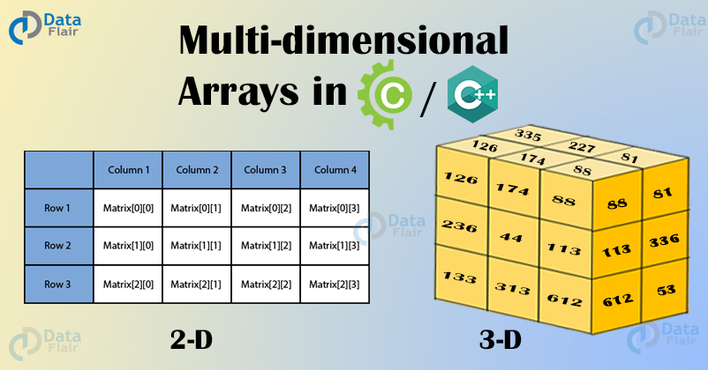
Multi-dimensional arrays

Slide 4
Multi-dimensional arrays
Why?
Store data of a ruby cube
By convention it is easy to access using indexing for each dimension
Array of arrays.
Data in multidimensional arrays are stored in tabular form (in row major order).

Slide 5
Multi-dimensional arrays
General form of declaring N-dimensional arrays:
data_type array_name[size1][size2]....[sizeN];
data_type: Type of data to be stored in the array.
Here data_type is valid C data type
array_name: Name of the array
size1, size2,... ,sizeN: Sizes of the dimensions

Slide 6
Size of multidimensional arrays
Product of size1,size2 etc
int x[10][20] can store total (10*20) = 200 elements.
int x[5][10][20] can store total (5*10*20) = 1000 elements.

Slide 7
Initializing Three-Dimensional Array
Use brackets for each dimension
Can give data in single curly beckets
Which one is good?

Slide 8
Initializing Three-Dimensional Array
Method 1:
int x[2][3][4] = {0, 1, 2, 3, 4, 5, 6, 7, 8, 9, 10, 11, 12, 13, 14, 15, 16, 17, 18, 19, 20, 21, 22, 23};
Better Method:
int x[2][3][4] = { { {0,1,2,3}, {4,5,6,7}, {8,9,10,11} }, { {12,13,14,15}, {16,17,18,19}, {20,21,22,23} } };

Slide 9
Accessing elements 3 D Arrays:
Accessing elements in Three-Dimensional Arrays is also similar to that of Two-Dimensional Arrays.
The difference is we have to use three loops instead of two loops for one additional dimension in Three-dimensional Arrays.

Slide 10
Accessing elements in 3 D Arrays:
Definition:
int arr [20][30][40];
Memory ?
Access:
Each element can be accessed as: arr [i][j][k]
What about base address+ index concept ?

Slide 11
Programs:
Write a program to find the sum of elements in a 3-D array [2x3x4]
(DIY)

Slide 12
Multi-dimensional arrays and pointers:
How to traverse the array using pointers?
To store address of an address?
int n=10;
int *p= &n;
int **q=&p;
Int ***r=&q;
Dereference at each level
That is by using * to pointer

Slide 13
Multi-dimensional arrays and pointers:
char board[3][3] = { {'1','2','3'}, {'4','5','6'}, {'7','8','9'} };
char *pboard = *board; // A pointer to char
for(int i = 0 ; i < 9 ; ++i) printf(" board: %c\n", *(pboard + i));

Slide 14
Multi-dimensional arrays and pointers:
How it works You initialize pboard with the address of the first element of the array, and then you use normal pointer arithmetic to move through the array: char *pboard = *board; // A pointer to char for(int i = 0 ; i < 9 ; ++i) printf(" board: %c\n", *(pboard + i));
Note how you dereference board to obtain the address you want (with *board). This is necessary because board by itself is of type char**, a pointer to a pointer, and is the address of the subarray board[0]. It is not the address of an element, which must be of type char*.

Slide 15
Dynamic Memory Allocation
Static Memory Allocation
int a=10 ?
int a[10] ?
int a[n]?
What if the demand is high for short time?
What if the array is no longer used ?
Need for run time allocation/de allocation

Slide 16
Stack Vs Heap
In a stack, the allocation and de-allocation is automatically done whereas, in heap, it needs to be done by the programmer manually.
Handling of Heap frame is costlier than handling of stack frame.
Memory shortage problem is more likely to happen in stack whereas the main issue in heap memory is fragmentation.
Stack frame access is easier than the heap frame as the stack has small region of memory and is cache friendly, but in case of heap, frames are dispersed throughout the memory so it causes more cache misses.
Stack is not flexible, the memory size allotted cannot be changed whereas a heap is flexible, and the allotted memory can be altered.
Accessing time of heap is more than a stack.

Slide 17
Dynamic memory allocation in C
Header file to be used:
Stdlib.h
Types of functions
malloc (create)
calloc(create)
realloc ( Change)
free ( Giveback)

Slide 18
Dynamic memory allocation in C
void *malloc(size_t size);
Description:
The malloc() function allocates size bytes and returns a pointer to the allocated memory. The memory is not initialized. If size is 0, then malloc() returns either NULL, or a unique pointer value that can later be successfully passed to free().
Return Value :
The function returns a pointer to the allocated memory that is suitably aligned for any kind of variable. On error, it returns NULL. NULL may also be returned by a successful call to malloc() with a size of zero.

Slide 19
Dynamic memory allocation in C
void *calloc(size_t nmemb, size_t size)
Description:
The calloc() function allocates memory for an array of elements of size bytes each and returns a pointer to the allocated memory. The memory is set to zero. If size is 0, then calloc() returns either NULL, or a unique pointer value that can later be successfully passed to free().
Return Value:
The function returns a pointer to the allocated memory that is suitably aligned for any kind of variable. On error, the function returns NULL. NULL may also be returned by a successful call to calloc() with size equal to zero.

Slide 20
Dynamic memory allocation in C
void *realloc(void *ptr, size_t size);
Description :
The realloc() function changes the size of the memory block pointed to by ptr to size bytes.
The contents will be unchanged in the range from the start of the region up to the minimum of the old and new sizes.
If the new size is larger than the old size, the added memory will not be initialized.

Slide 21
Releasing Dynamically Allocated Memory
De allocate the memory once done
If not done, it will be there in the system with no reference
Memory leak
Use free function
void free(void *ptr);
Rules on *ptr

Slide 22
Structures
Arrays
Homogenous data
Need for mixed data
Student data
Employee data
Book data
Bind the logical entities in a single block

Slide 23
Defining a structure
struct struct-tag
{
Data_type data_member1;
Data_type data_member2;
…
};
struct is a keyword

Slide 24
Creating structure variable
struct struct-tag
{
Data_type data_member1;
Data_type data_member2;
…
};
struct struct-tag var;

Slide 25
Accessing structure Variable
Use member of operator (i.e dot)
Variable at left, member name at right
struct point{
int x;
Int y; };
struct point p;
p.x=10;

Slide 26
Structure variable types
struct point p; // After struct tag
struct point { int x;int y} p; //Along with struct tag
struct point { int x;int y} p;
Struct point q;
Now both p and q are valid

Slide 27
Initializing structure variables
Initialize with respect to data members
Use curly backets
struct point p={1,2}; //both are same
struct student
{
int rolll;
char name[10];
};
struct student s={1,”Chinmay”};//Mixed

Slide 28
Un-named structures
struct { int a; int b;} p;
Pro:
Quick
Con:
No struct tag
Can’t be reused

Slide 29
Array of structures
Let’s say we want 3 points
struct point p1,p2,p3
Problem?
struct point p[3]; //array of structures
Each array element will hold on structure variable (i.e one point in out case)
Access: p[2].x, p[1].y ( Use indexing)

Slide 30
Nested Structures
Nested loops:
Loop inside loop
Structure inside a structure
Can be defined and then used
Can be directly used as a data member
For java/c++ geeks: There is no inheritance in native C. [is-a,has-a]

Slide 31
Nested Structures
struct point
{
int x; int y
};
struct line l {
struct point p1;
struct point p2;
}

Slide 32
Structures and pointers
Need to remember address of a structure variable?
Create pointer of same type
struct point p;
p.x=10;
struct point * q= &p;
printf(“%d”,(*q).x);

Slide 33
Structures and pointers
Member-of(dot) has higher precedence:
Use brackets
Use arrow
printf(“%d”,(*q).x);
printf(“%d”,q->x);

Slide 34
Llinked List
Please watch this animated video and comeback
https://www.youtube.com/watch?v=xiIoa2rfAaQ
Hope you got the concept!

Slide 35
Llinked List
Contiguous memory allocation:
Big memory chunk is required
Small chunks may be available
Concept of linked list:
Use small chunks and connect them
Each small chunk is called node and they will store the address/addresses of other chunks

Slide 36
Types of linked list
Singly linked list
Only forward
Doubly linked list
forward and backward
Circular linked list
Head and tail will meet at same
Pros and cons ?

Slide 37
Singly linked list in C
Representing node
using structures
data part as normal data members
links as pointer inside a node definition
Start node:
Generally refered as head or first. It is a pointer.
Traverse:
Using pointer value stored in each node

Slide 38
Creating singly linked list
struct node
{ int data;
struct node * next;
};
struct node * head=NULL;

Slide 39
Creating a node
As link list can grow and shrink at run time go for dynamic memory allocation
struct node * temp;
temp=(struct node *)malloc(sizeof(struct node));
malloc must receive sizeof a node not node *
Use functions and call it as many times you like

Slide 40
Inserting the node
The node can be inserted in various locations
Start (Update the head)
End (next is pointing to NULL)
Given position
count the position and insert
Given data
search for a node data and insert

Slide 41
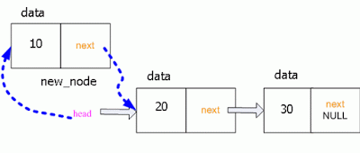
Insert at the start
Create new_node
new_node->next=head
head=new_node

Slide 42
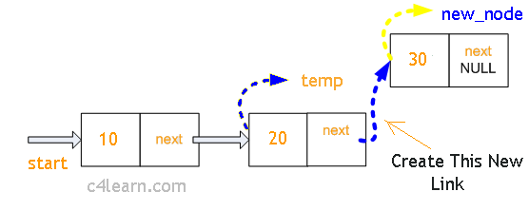
Insert at the end
Create new_node
Traverse till last node (temp)
temp->next=new_node

Slide 43
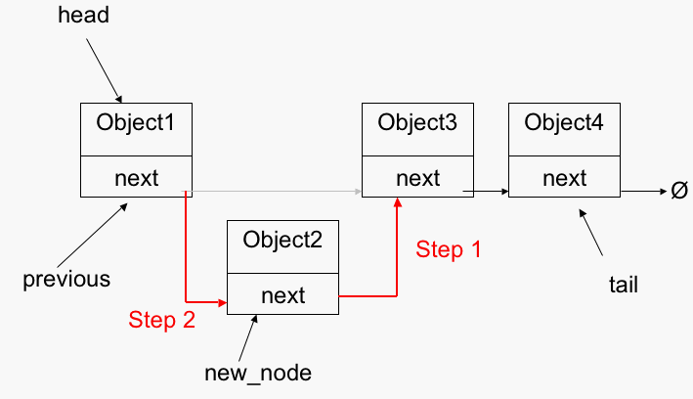
Insert at the given pos
Create new_node
Traverse till given node -1(prev)
new_node->next=prev->next
prev->next=new_n0de

Slide 44
Delete node in singly linked list
If book details are stored in linked list then removing a book will make delete node operation
Just like insert , delete will happen in four pos (start,end, given data, given pos)
Use free function to remove the node from the system.
Just deleting the link will cause memory leak!

Slide 45
Summary
Multi dimensional Array: Multiple indexing but linear memory
Dynamic memory allocation: Serve the demand of the memory
Structures: Store and access the heterogeneous data
Linked list: Use small chunks and connect them instead of waiting for big memory chunk

Slide 46
Thank you
For any queries please contact
chinmaysubraybhat@pes.edu
Hands-on sessions done in the class are available in impartus. Please refer to it.
This slide has been prepared for section R & U 2019-20 batch just as an overview. Refer the original slides shared by anchor teacher for more details.

